Slide 1
Predicting High-Value Customers in Online Retail Using Machine Learning
An Tian

Slide 2
1. Project Overview
This project aims to identify high-value customers in online retail using machine learning techniques. We developed a Random Forest classifier to predict customers with high spending potential based on their transaction history. The model helps optimize marketing resource allocation and improve customer retention strategies.

Slide 3
2. Data Preparation
Dataset: UCI Online Retail Dataset
Source URL: https://archive.ics.uci.edu/ml/machine-learning-databases/00352/Online%20Retail.xlsx
Original Data: 541,909 transaction records
Fallback: Code automatically generates synthetic data if network connection fails
The dataset contains transaction records with the following fields:
InvoiceNo StockCode
Description Quantity
InvoiceDate UnitPrice
CustomerID Country

Slide 4
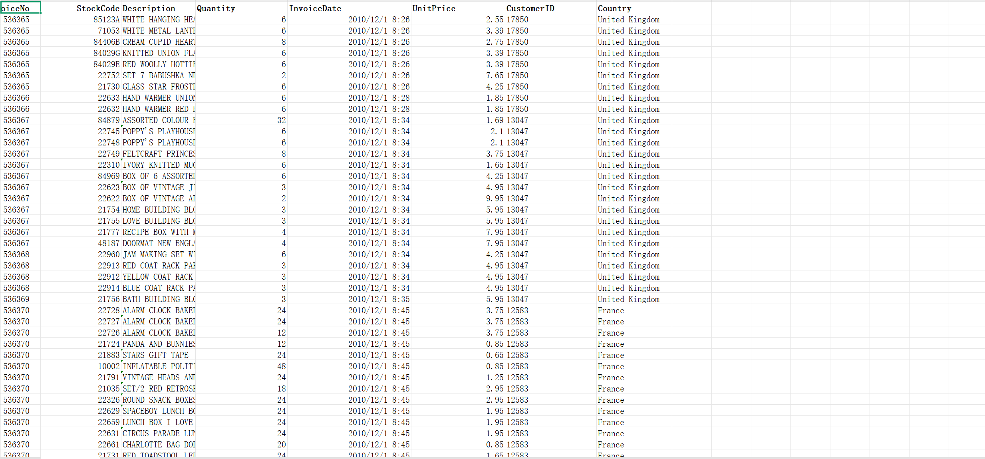
2.1 Data Source & Loading

Slide 5
2.2 Data Preprocessing
Data Cleaning:
Identified and removed canceled transactions (invoices starting with 'C')
Handled missing values and outliers
Feature Engineering:
Created target variable (high_value customers based on median spending)
Calculated total spending per customer
Extracted temporal features (hour, day of week, month)

Slide 6
2.2 Data Preprocessing
Feature Extraction:
Transaction count
Unique products purchased
Average purchase quantity
Active months count
Total quantity purchased
Average and maximum unit price

Slide 7
3. Exploratory Data Analysis (EDA)
Target Distribution:
Near 1:1 ratio between high/low-value customers (after median split)
Feature Patterns:
High-value customers have significantly more transactions
Product variety positively correlates with customer value
High-value customers show more uniform shopping time distribution
Feature Correlations:
Transaction count shows highest correlation with customer value
Active months count is the second most important predictor

Slide 8
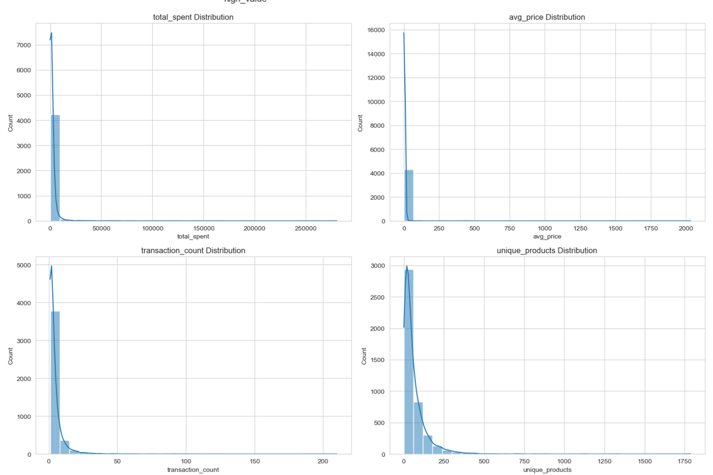
3. Exploratory Data Analysis (EDA)

Slide 9
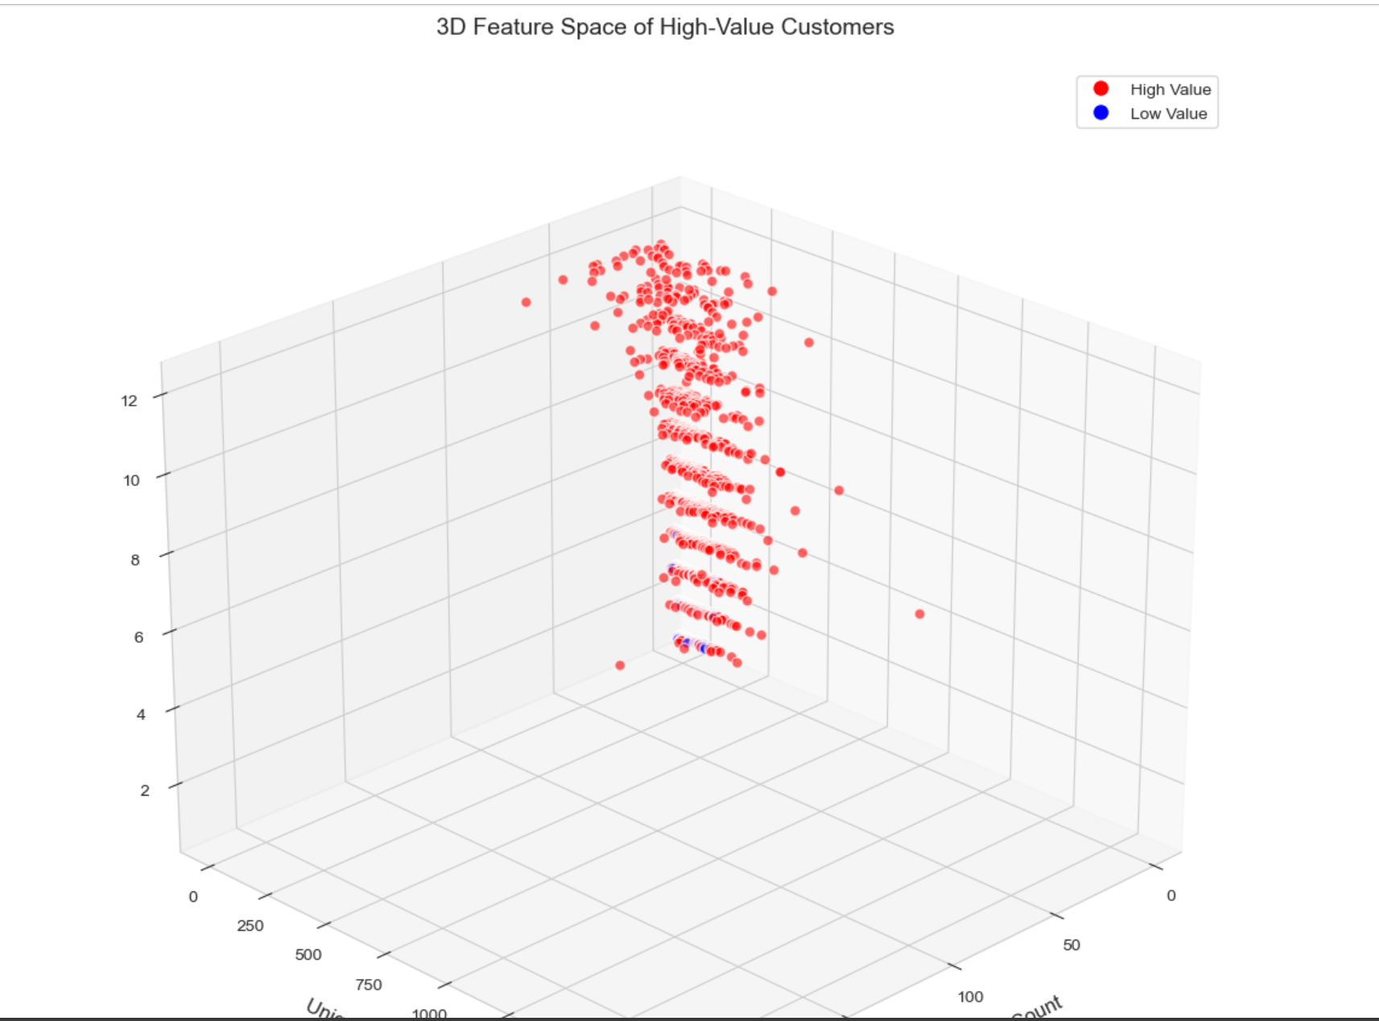
3. Exploratory Data Analysis (EDA)

Slide 10
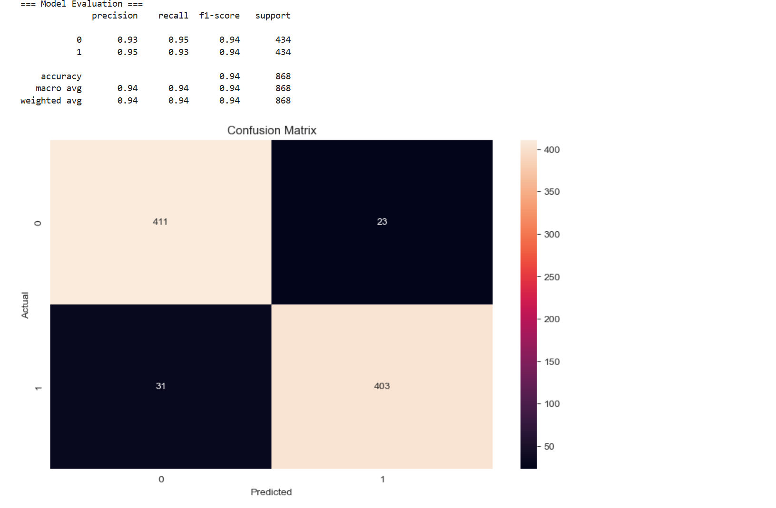
4. Model Evaluation

Slide 11
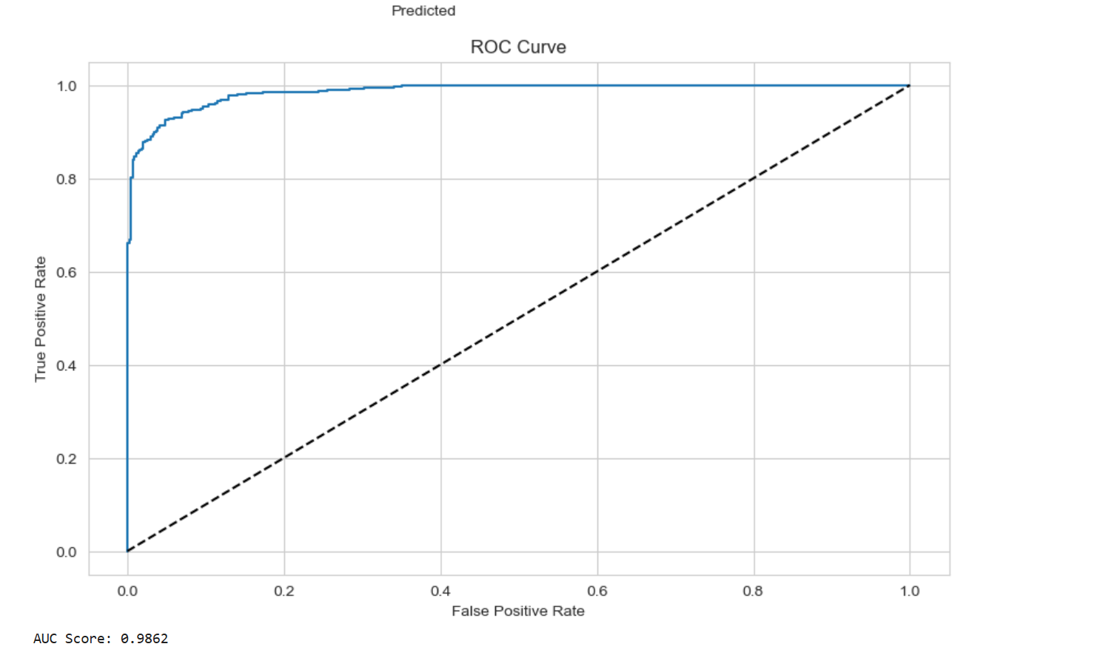
4.Model Evaluation

Slide 12
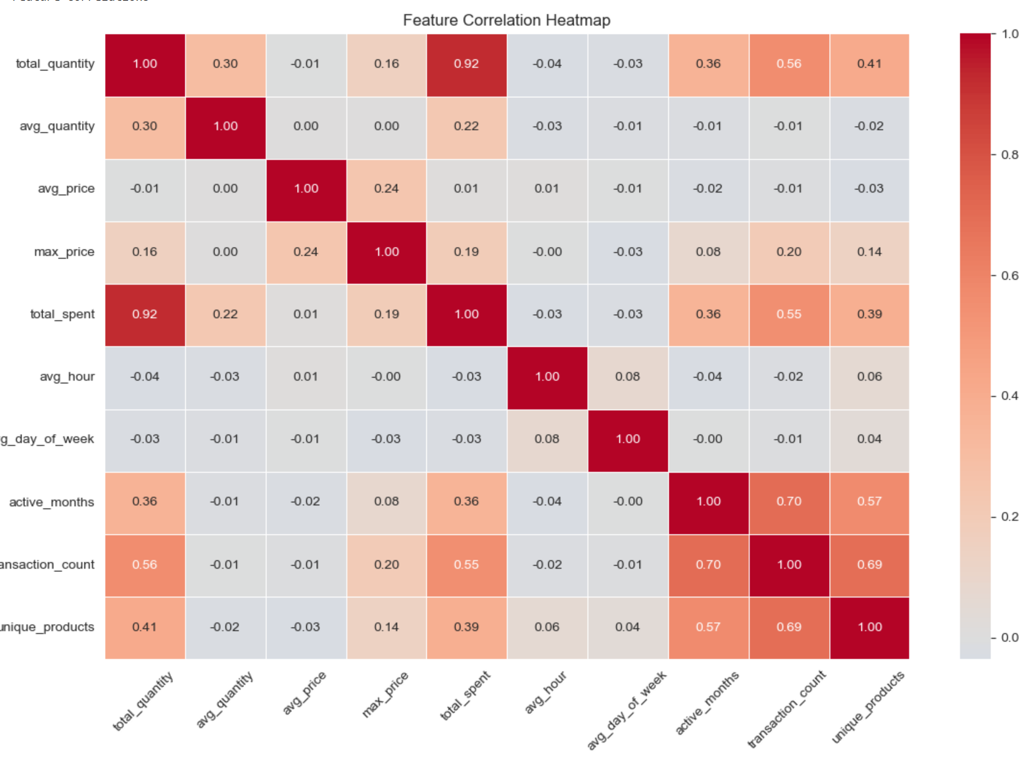
5.Feature Correlations

Slide 13
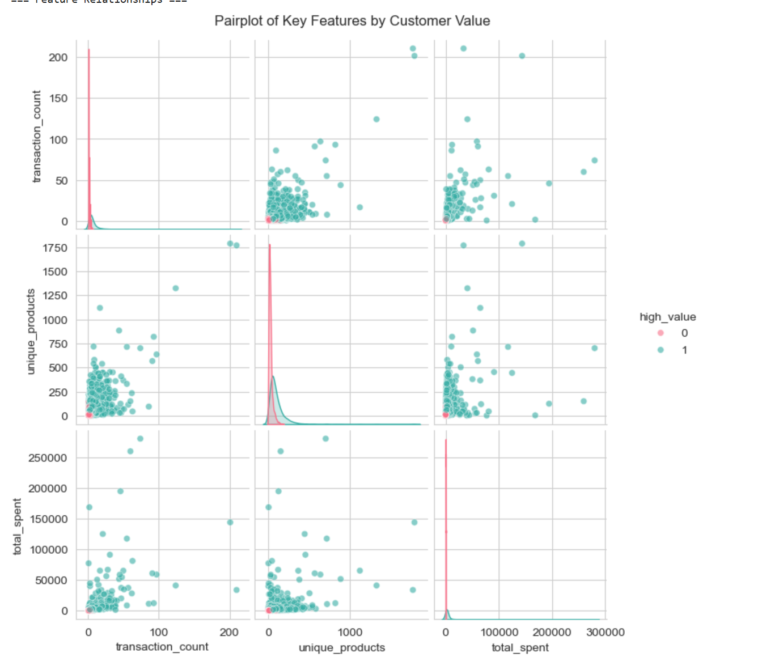
5.Feature Correlations

Slide 14
6. Results
The Random Forest classifier achieved strong performance in identifying high-value customers. Key metrics include:
High precision and recall for the high-value class
ROC AUC score indicating good separability between classes
Feature importance analysis revealing most predictive features

Slide 15
7. Limitations and Future Work
Limitations:
Data only represents a specific time period
Limited customer demographic information
Potential seasonality effects not fully captured
Future Improvements:
Incorporate additional data sources (demographics, website behavior)
Experiment with other algorithms (XGBoost, Neural Networks)
Implement real-time prediction capabilities
Develop dynamic customer segmentation

